Slide 1
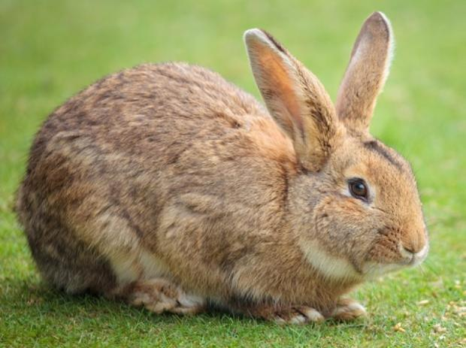
Image Classification
A core task in computer vision
Given an image, classify/categorize it into a set of pre-specified discrete classes, e.g., rabbit, cat, glass, plane.
The class/category of an image is also called its ‘label’.
A label is assigned to the whole image, not individual objects.
Rabbit
Notes:
Handouts: http://cs231n.github.io/classification/#intro

Slide 2
An Image Classifier
>> f = imread('rabbit.jpg');
>> predict(f)
????
Unlike conventional algorithms with fixed number of steps, sorting a list of numbers,
There is no obvious way to hard-code the algorithm for recognizing a cat, or other classes.

Slide 3
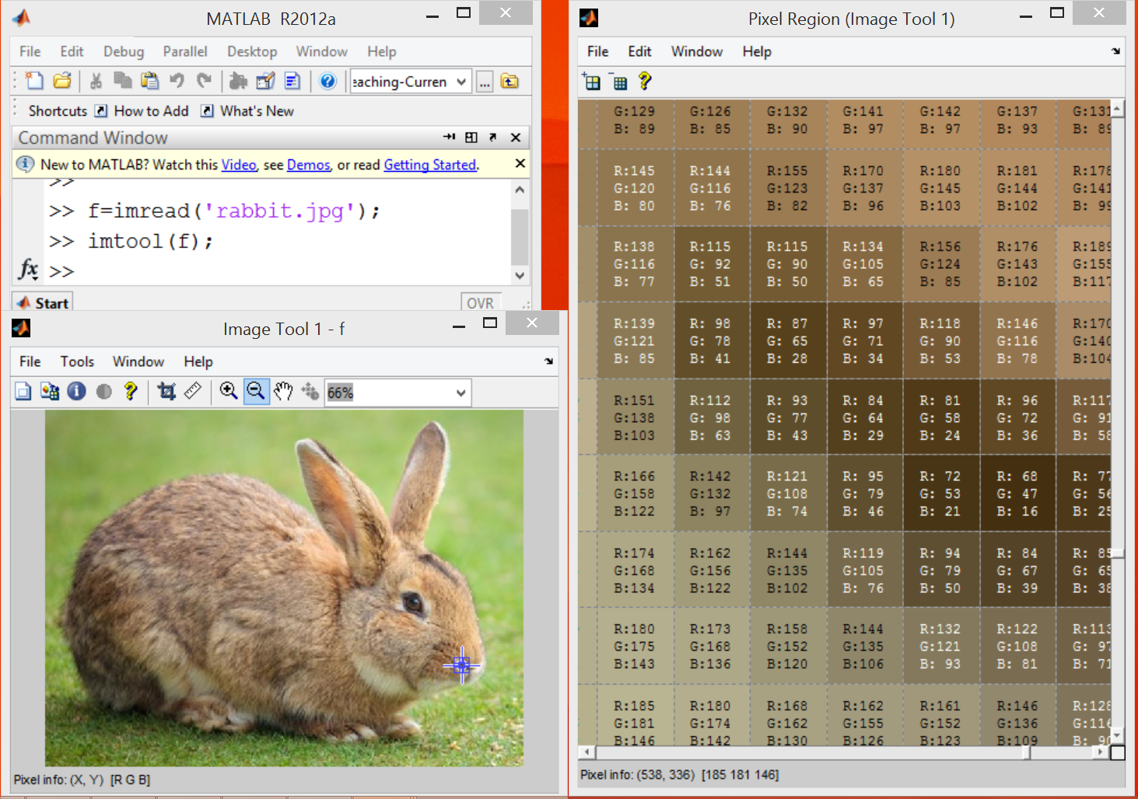
Image Classification: The Problem
Human vs Machine Perception: Images are represented as R^{d} arrays of numbers, e.g., R³ with integers between [0, 255], where d = 3 represents 3 color channels (RGB)
What the machine (computer) sees

Slide 4
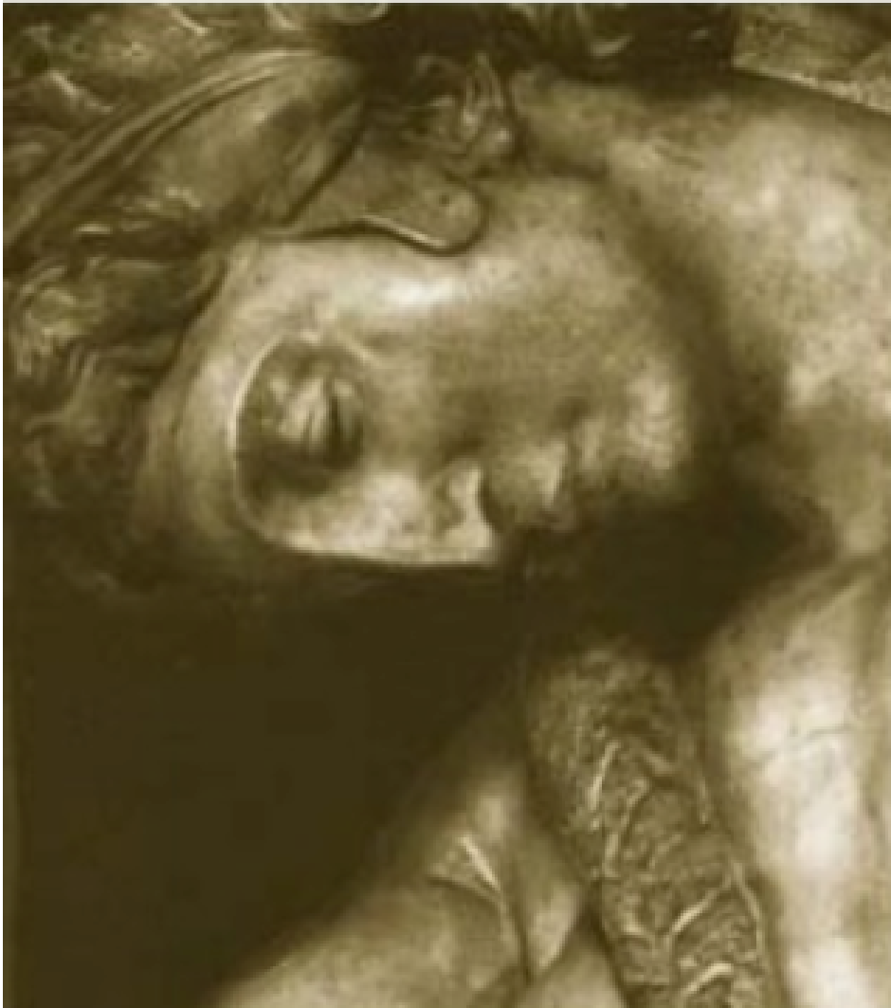
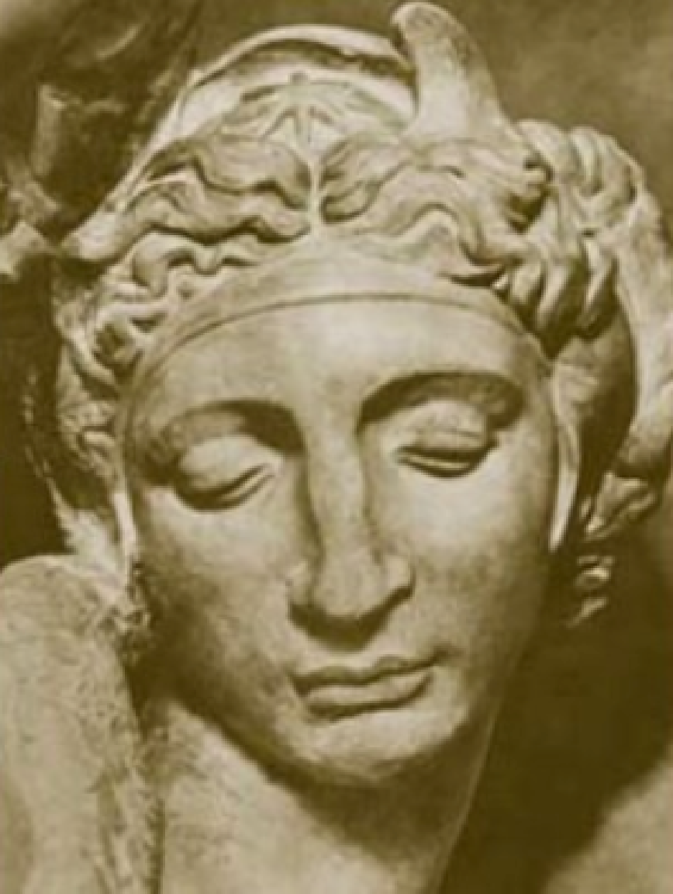
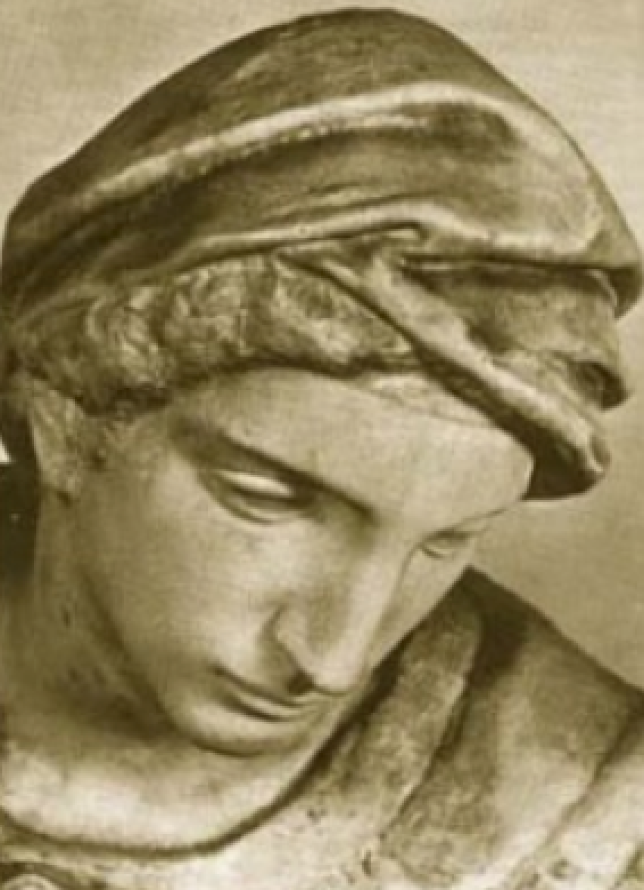
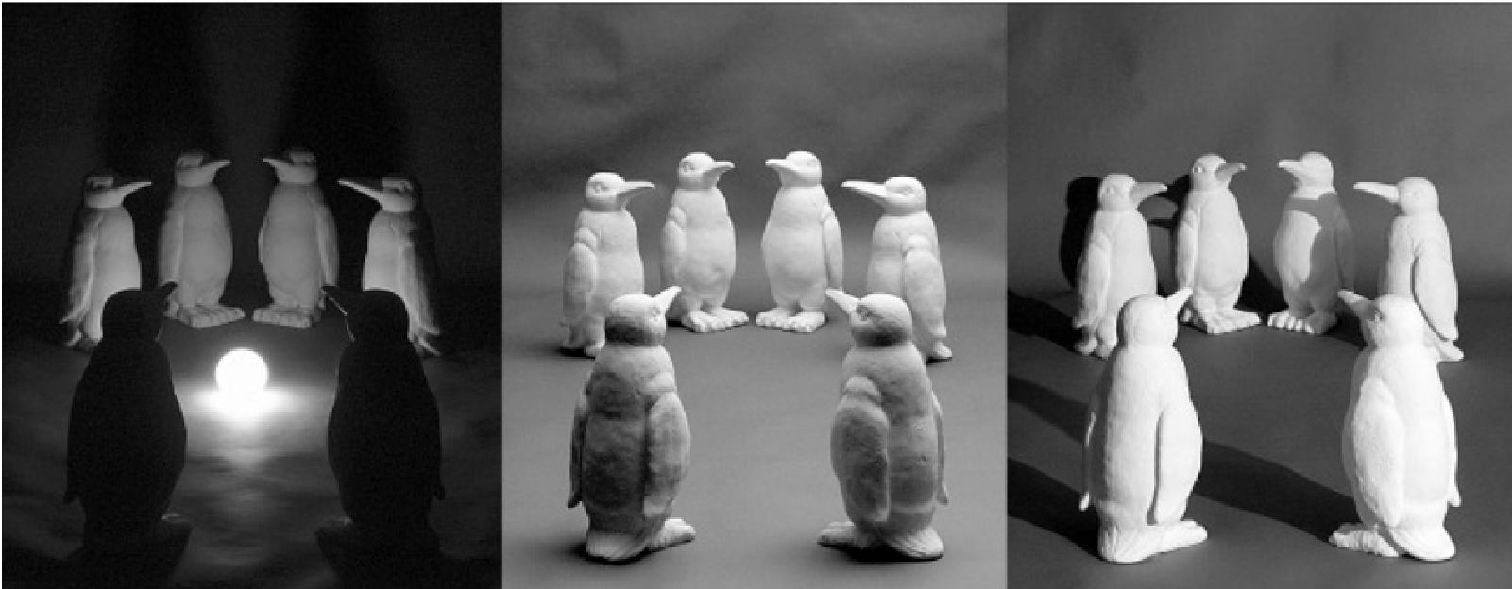
Image Classification: Challenges
Viewpoint variation
Illumination
Michelangelo 1475-1564

Slide 5
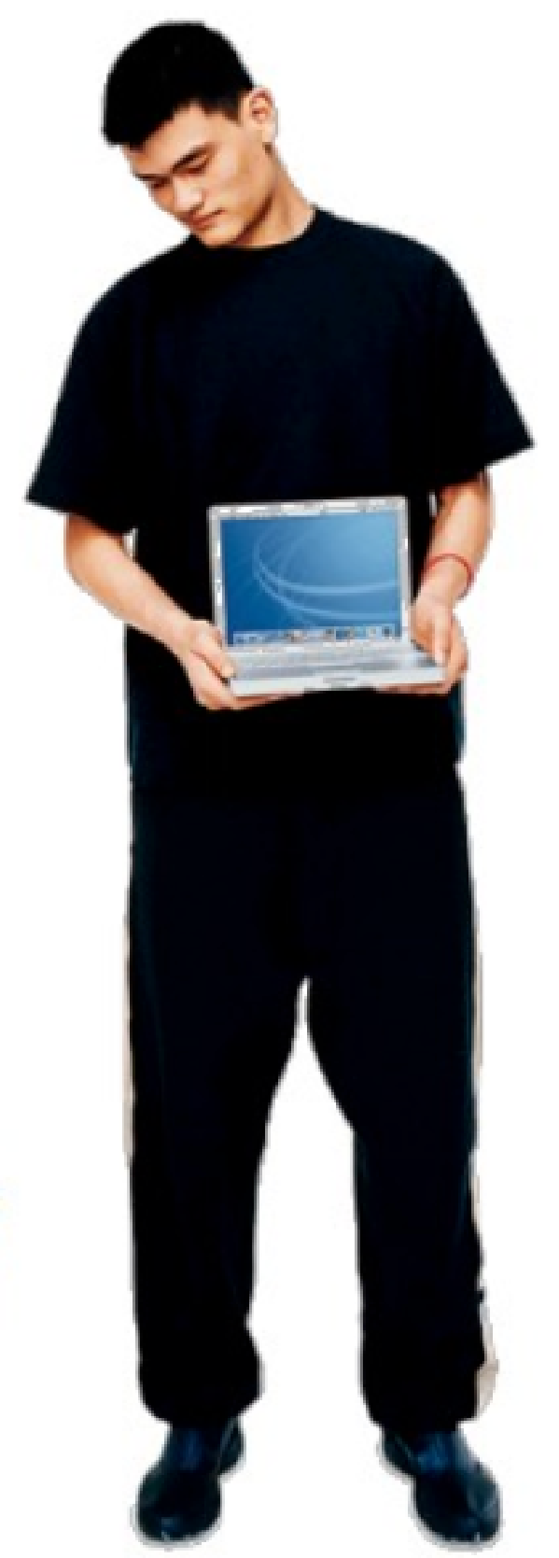

Image Classification: Challenges
Scale

Slide 6
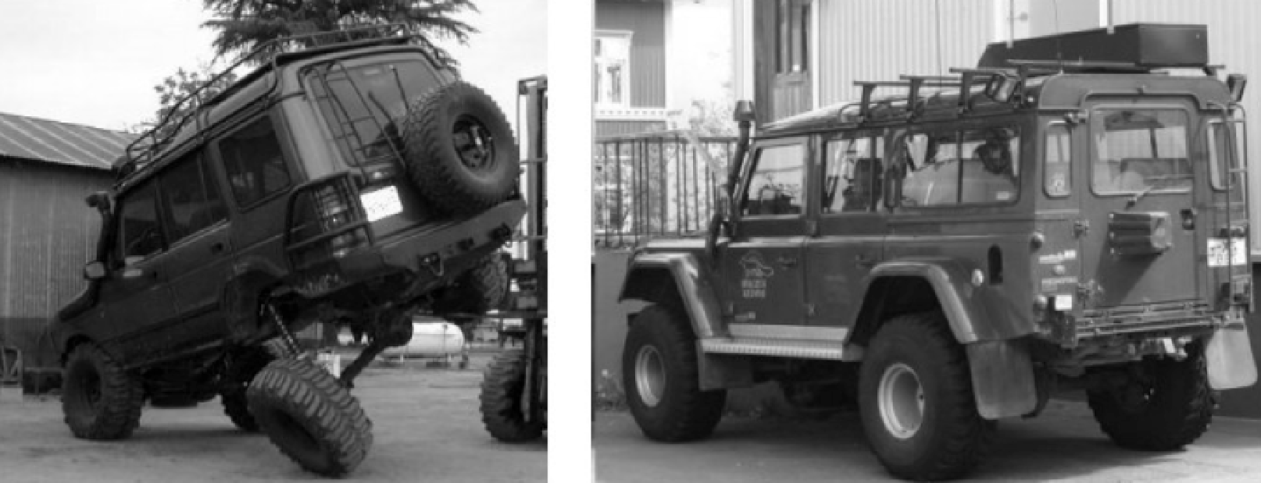
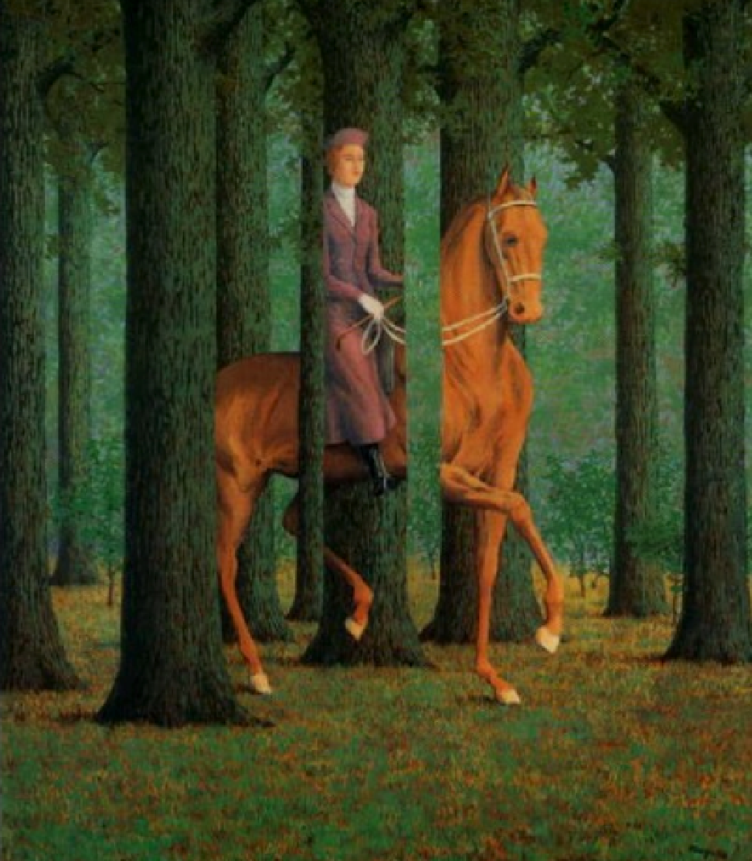
Image Classification: Challenges
Deformation
Occlusion

Slide 7
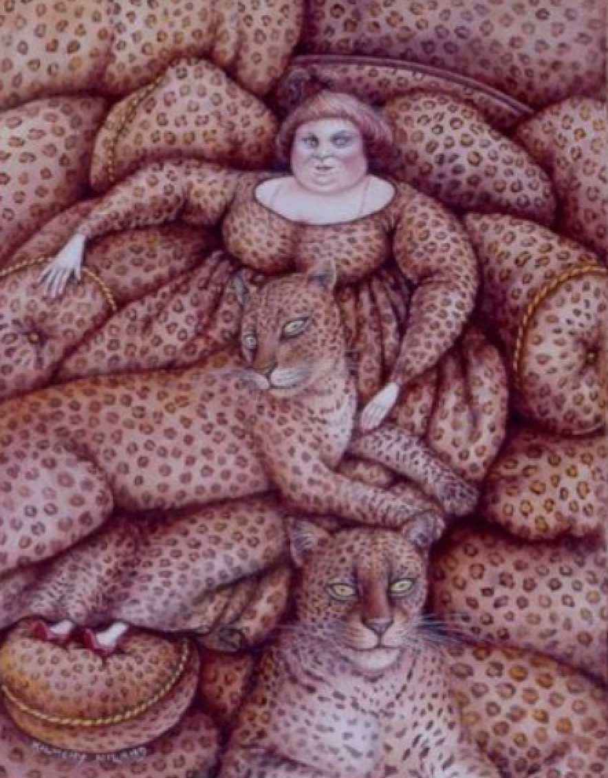
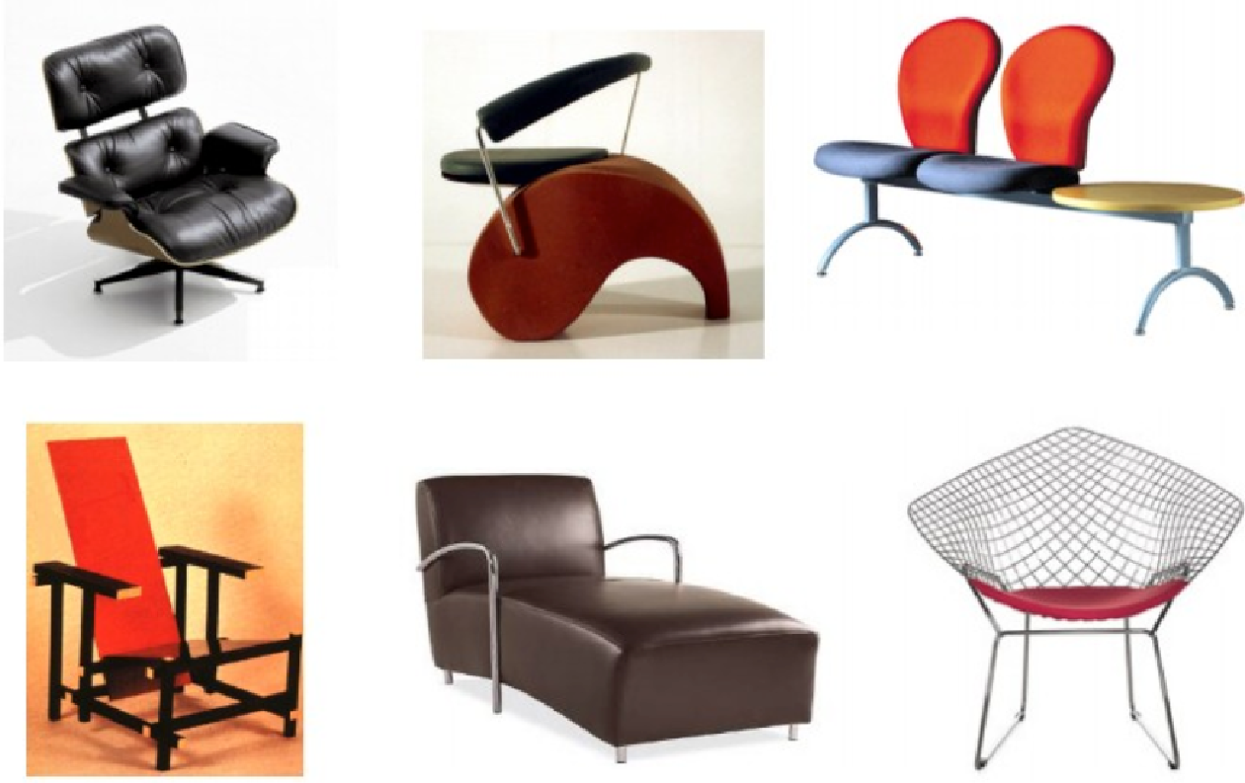
Image Classification: Challenges
Background clutter
Intra-class variation
Kilmeny Niland 1995

Slide 8
An Image Classifier: Data-driven approach
The traditional solution to the image classification problem is 2-fold:
First, extract meaningful information from images, which is invariant to image noise such as scale, rotation, illumination, viewpoint etc.
Examples: texture features, HOG, SURF etc.
Use a lot of example images (called the training set) of each class/category to ‘train’ an image classifier.
Examples: KNN, SVM, Random Forest, Artificial Neural Networks and a lot more...

Slide 9
An Image Classifier: Data-driven approach
The trained classifier can be used to predict unseen images (called the test set), which are not part of the training set.
This will give an idea of how accurate the classifier is in classifying the images into the given set of classes.

Slide 10
The Image Classification Pipeline
Input: Our input consists of a set of N images, each labelled with one of K different classes. This forms our training set.
Learning: Our task is to use the training set to learn what every one of the classes looks like. We refer to this step as training a classifier, or learning a model.
Evaluation: We evaluate the quality of the classifier by asking it to predict labels for a new set of images that it has never seen before. We will then compare the true labels of these images to the ones predicted by the classifier. Intuitively, we're hoping that a lot of the predictions match up with the true labels (which we also call the ground truth).

Slide 11
The Machine Learning Framework
This can be represented mathematically as:
y = f(x)
Output Prediction function Image feature
Training: given a training set of labelled examples {(x₁,y₁), …, (x_{N},y_{N})}, during training, we estimate the prediction function f by minimizing the prediction error on the training set.
Testing: apply f to an unseen test image example x and output the predicted value y = f(x).

Slide 12
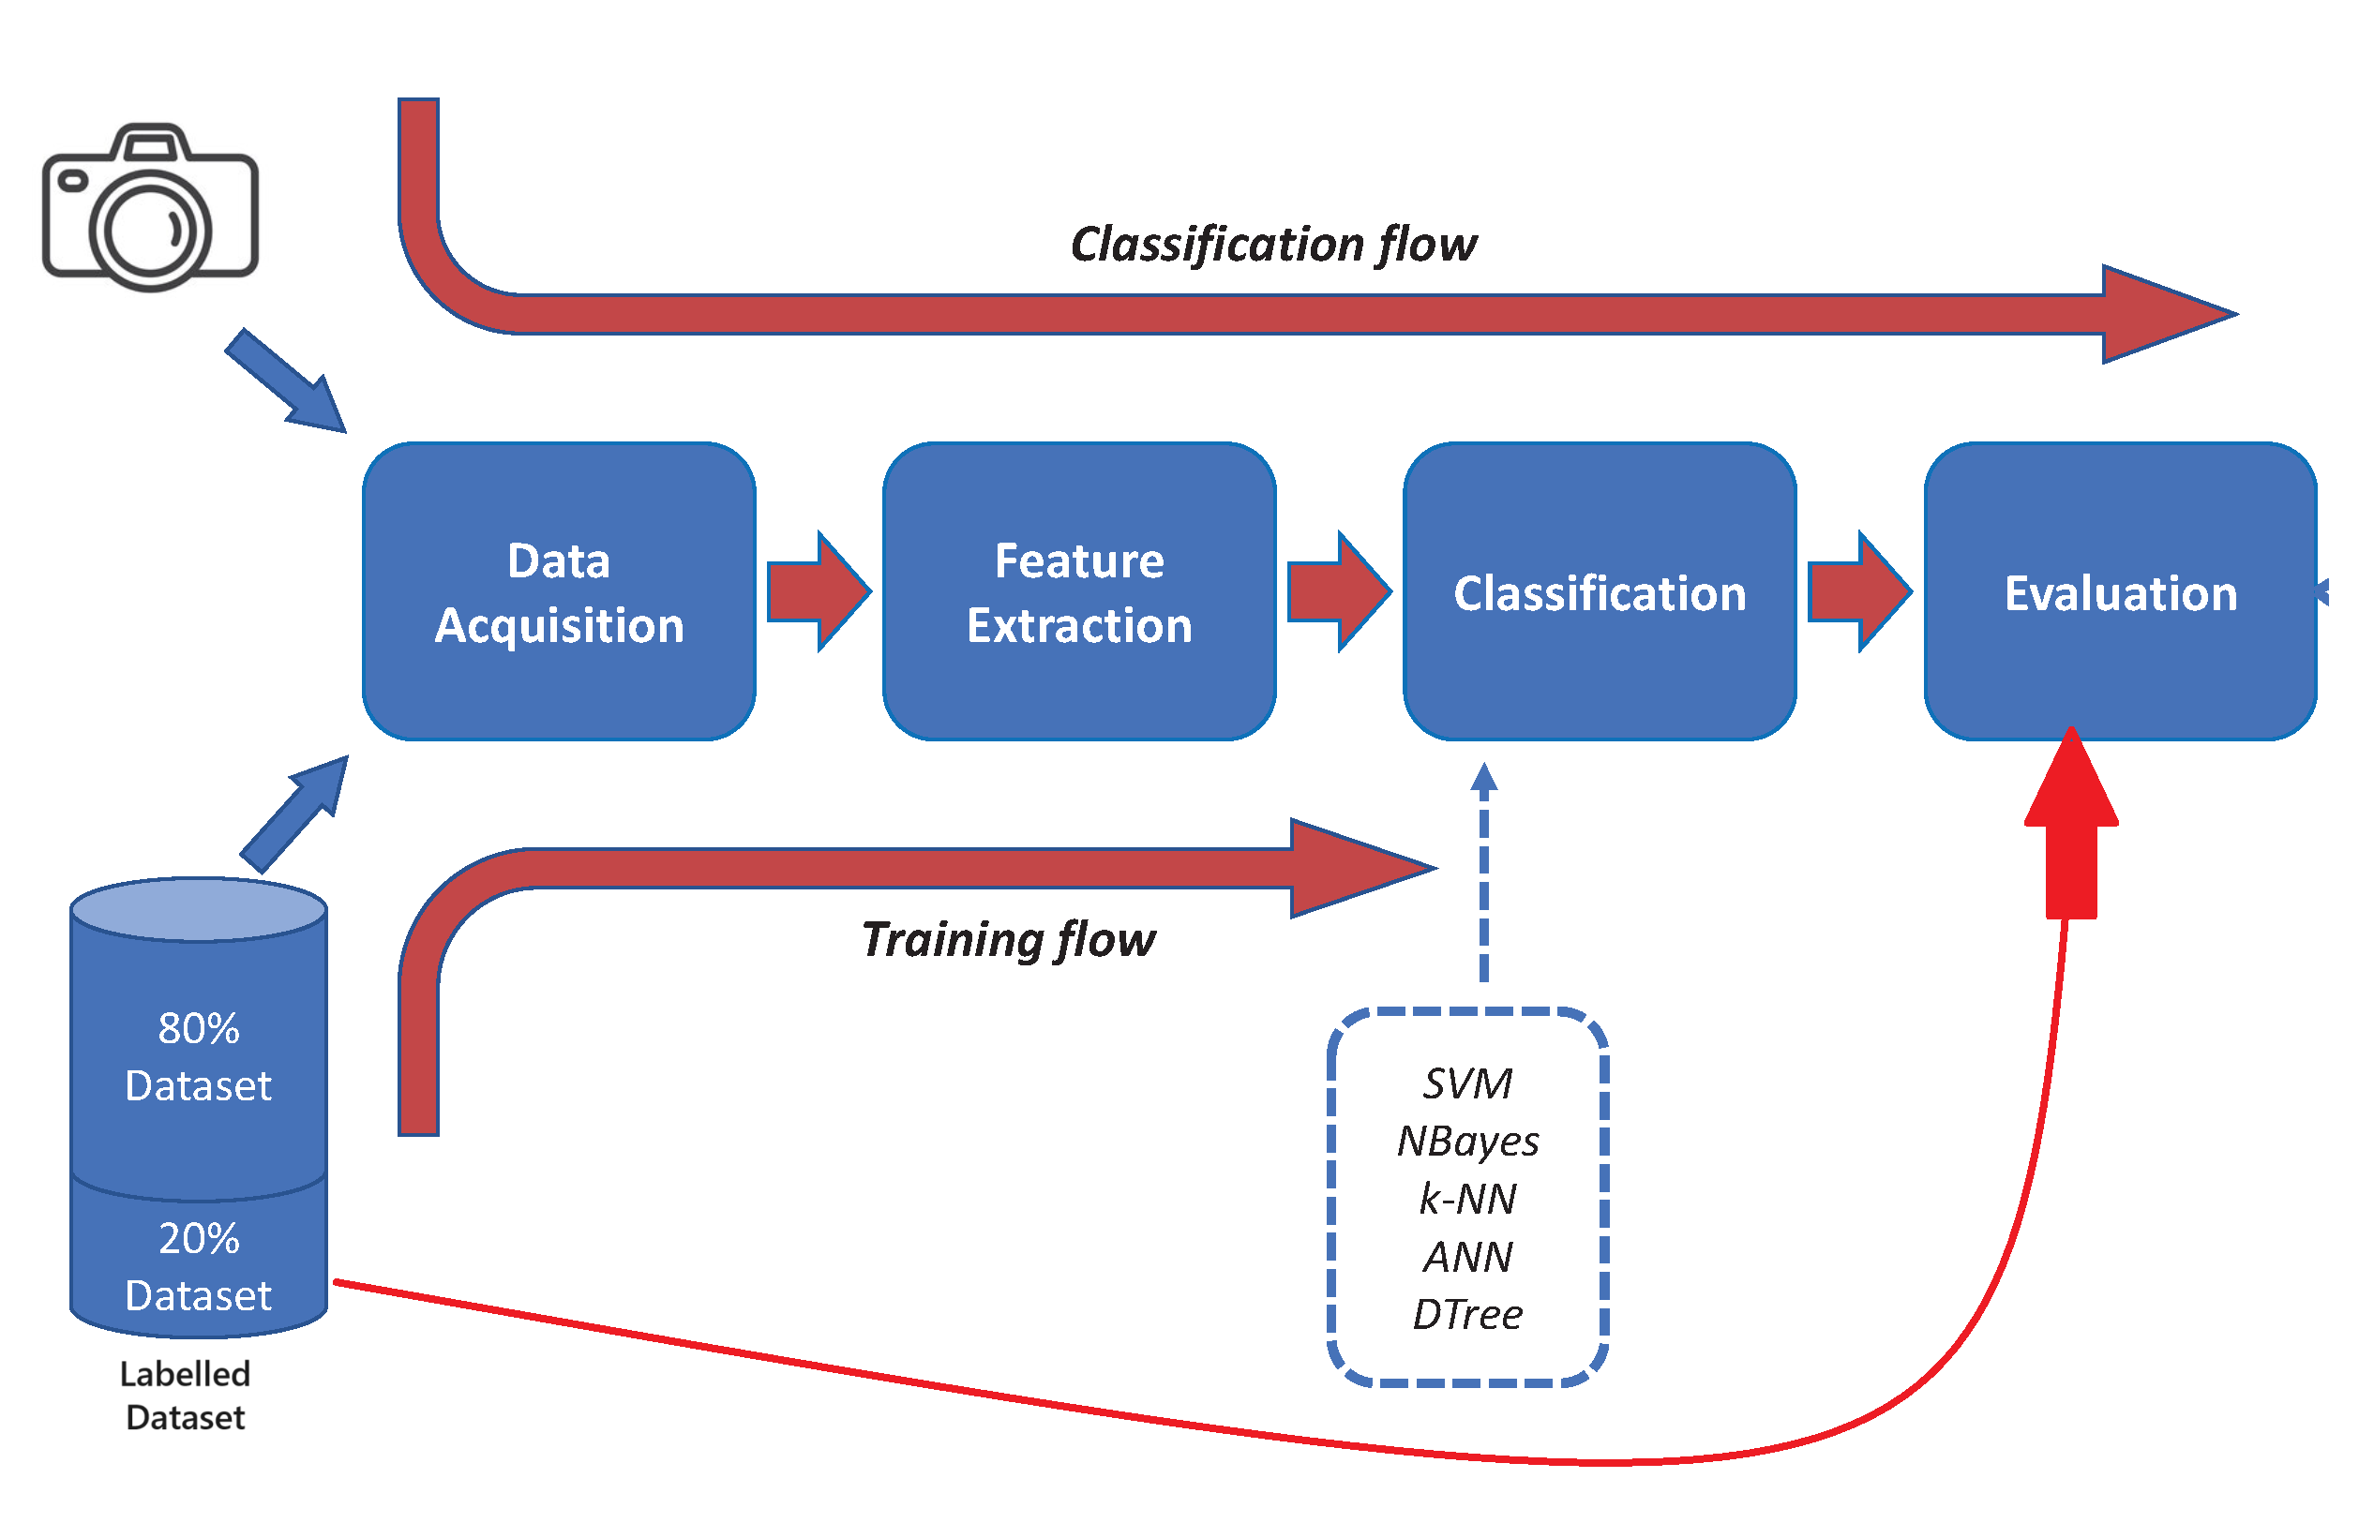
A typical classification workflow

Slide 13
Classification algorithms
There are a lot of classification algorithms developed so far. Some examples are:
K-Nearest Neightbours (KNN) classifier
Support Vector Machines (SVM)
Decision Trees (DT)
Artificial Neural Networks (ANN)
We will discuss KNN as an example classifier due to its simplicity.

Slide 14
K-Nearest Neighbor Classifier
Key Idea:
In comparison to other ML based classifiers, KNN does not involve a training step.
Rather, for each test example, simply assign it the label/class according to the labels of the K-nearest training data points.
The label of the majority class is assigned to the test example.
But, how is the ‘nearest’ defined – a notion of distance between feature vectors is considered here.

Slide 15
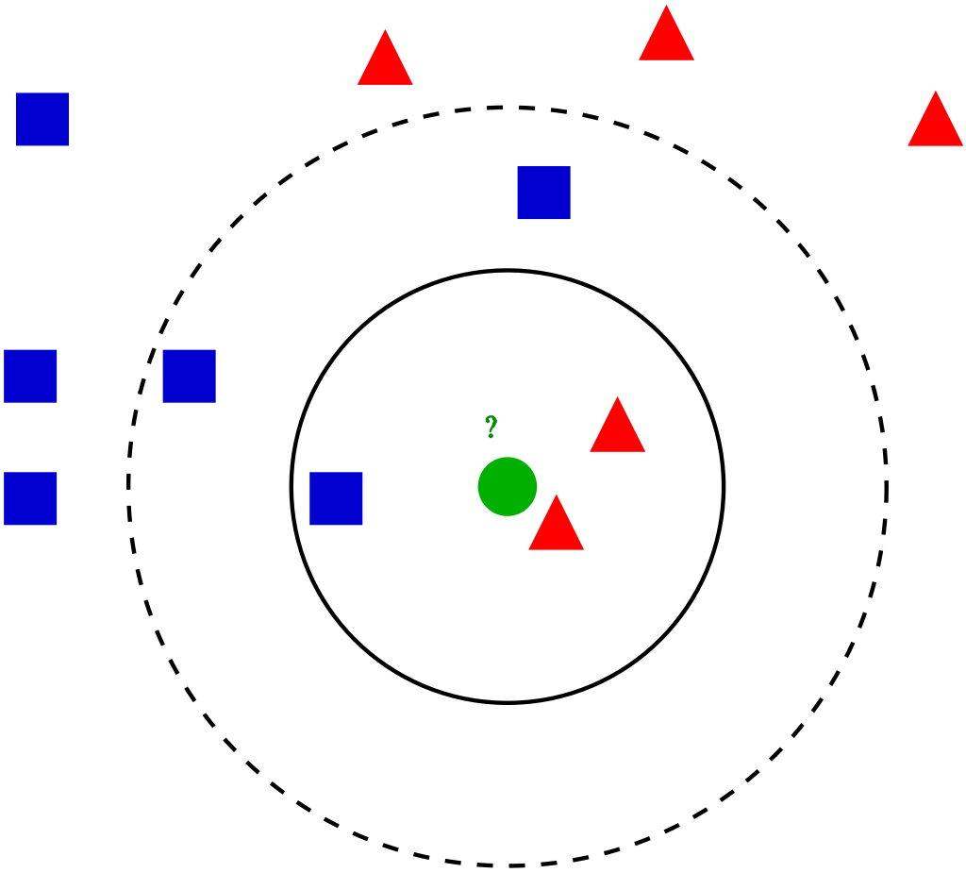
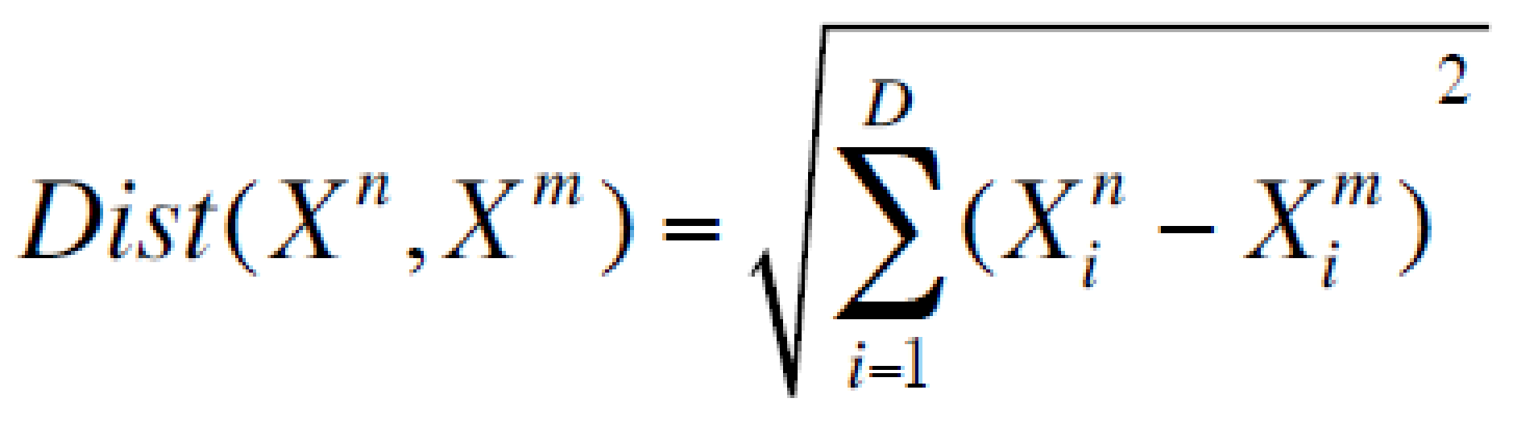
KNN: distance metrics
Distance metric/measure: Euclidean
where X^{n} and X^{m} are the n-th and m-th data points. We can assume that m-th data point is a test example.
The test sample (green dot) should be classified either to blue squares or to red triangles. If k = 3 (solid line circle) it is assigned to the red triangles because there are 2 triangles (majority class) and only 1 square inside the inner circle. If k = 5 (dashed line circle) it is assigned to the blue squares (3 squares vs. 2 triangles inside the outer circle).

Slide 16
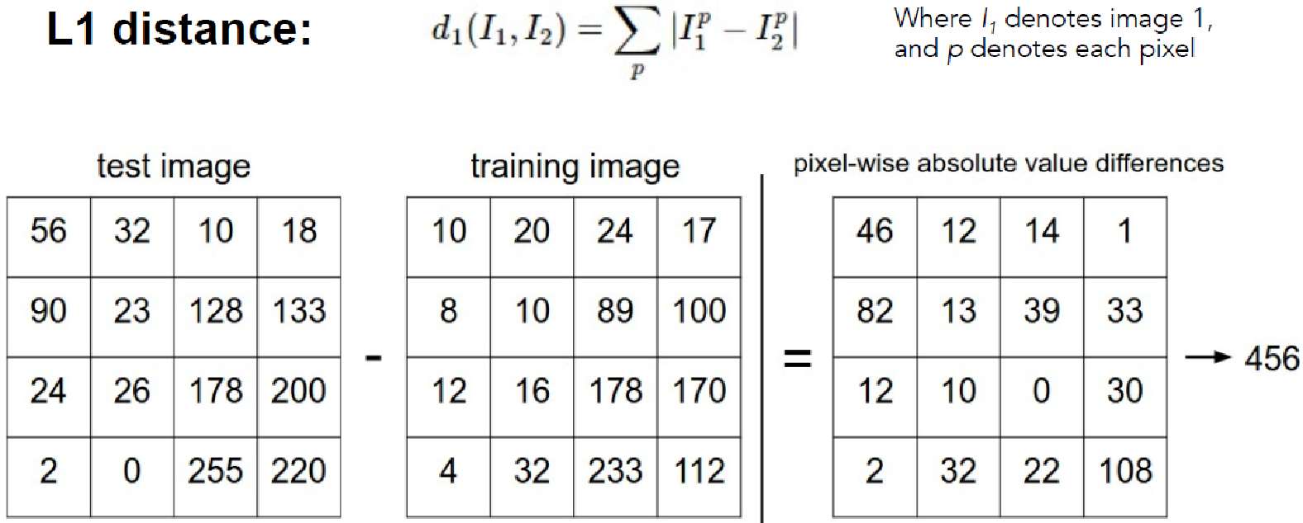
KNN: distance metrics
Another popular distance metric/measure is the L1 distance, which is computed by the equation given below:

Slide 17
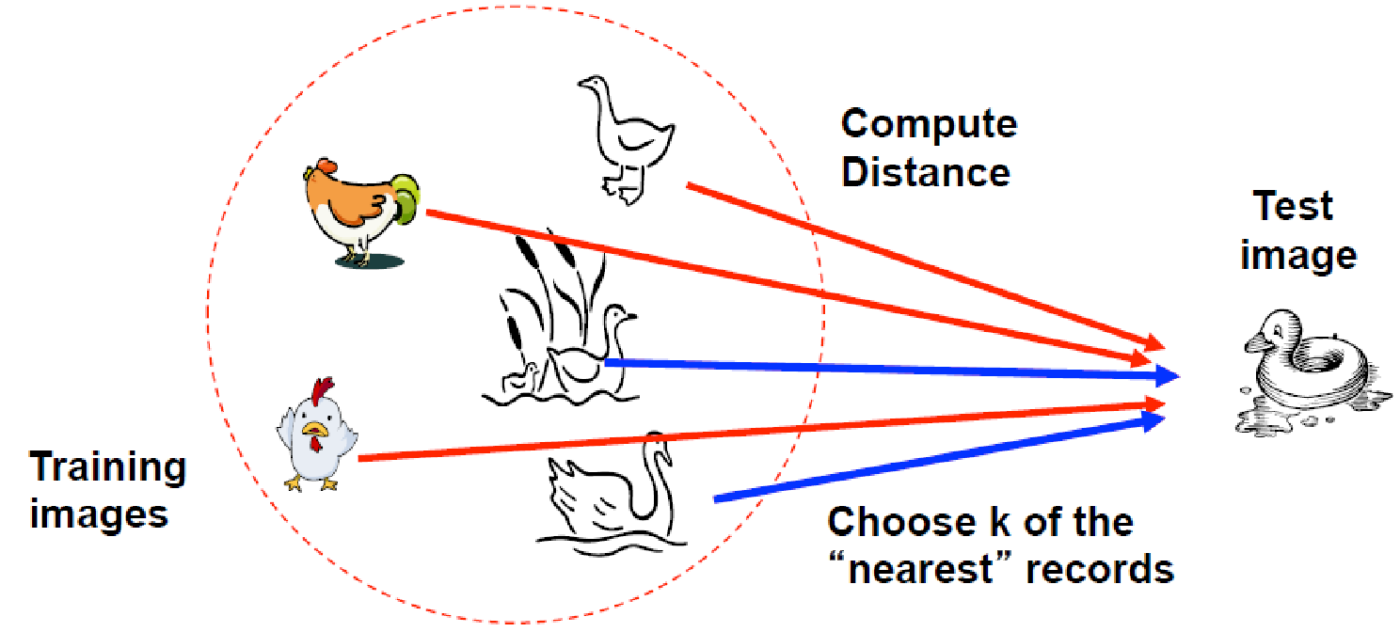
K-Nearest Neighbor Classifier

Slide 18
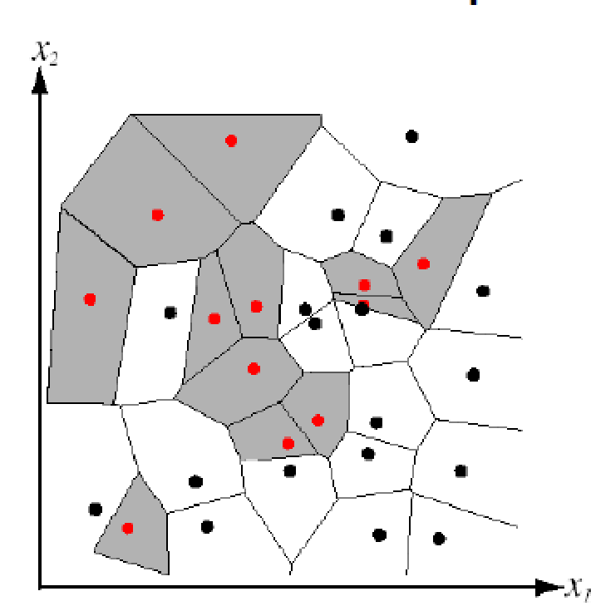
Nearest Neighbor Classifier
Let’s assume K=1: this is a special case of KNN called the ‘nearest neighbor’ classification.
Here, we simply assign the label of the nearest training data point to each test data point.
The figure on right shows the partitioning of feature space for a 2-class problem (red vs black) using the nearest neighbor algorithm.
Any test example within a particular region will be classified into the corresponding training example.
Partitioning of feature space for a two-class 2D data (i.e. 2 features)

Slide 19
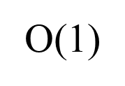
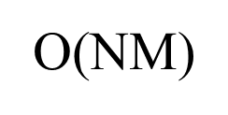
KNN vs K-Means Clustering
Q: What is the complexity of the 1-NN classifier w.r.t. training set of N images and test set of M images?
at training time?
at test time?

Slide 20
Example – classifying fruit images
Let’s see we want to classify 3 types of fruit using KNN.
We will first extract HOG features for each image and then apply KNN algorithm for prediction. The detailed steps are as follows:
Load the dataset: it is assumed that each fruit images are grouped into a folder with the fruit name.
Pre-process: resize to a fixed size (64x128).
Feature extraction: extract the HOG features.
Train-test split: split the dataset into training and test set.
Classify: Apply KNN classification with K=5 to the test set.

Slide 21
Example code – classifying fruit images using KNN
from skimage.feature import hog
from skimage.io import imread
from skimage.transform import resize
from sklearn.model_selection import train_test_split
from sklearn.neighbors import KNeighborsClassifier # KNeighborsClassifier
from sklearn.metrics import classification_report
import numpy as np
import glob

Slide 22
Example code – classifying fruit images using KNN
# Load dataset
fruit_images = []
fruit_labels = []
for fruit_type in ['apple', 'banana', 'orange']:
for image_path in glob.glob(f'path_to_dataset/{fruit_type}/*.jpg'):
image = imread(image_path)
image = resize(image, (128, 64)) # Resize images to a fixed size
fruit_images.append(image)
fruit_labels.append(fruit_type)
# Extract HOG features
hog_features = [hog(image, pixels_per_cell=(8, 8), cells_per_block=(2, 2), visualize=False) for image in fruit_images]
hog_features = np.array(hog_features)

Slide 23
Example code – classifying fruit images using KNN
# Prepare labels
labels = np.array(fruit_labels)
# Split dataset
X_train, X_test, y_train, y_test = train_test_split(hog_features, labels, test_size=0.2, random_state=42)
# Train a classifier using KNN
knn_clf = KNeighborsClassifier(n_neighbors=5) # Using KNN with n_neighbors set to 5
knn_clf.fit(X_train, y_train)
# Predict and evaluate
y_pred = knn_clf.predict(X_test)
print(classification_report(y_test, y_pred))

Slide 24
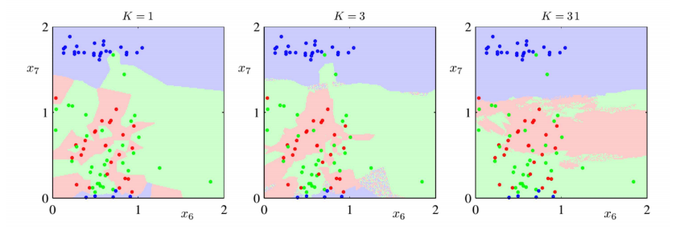
K Nearest Neighbor (KNN)
Caution: Be careful when choosing K.
Very low value of K may cause overfitting (too much biased towards the training data)
Very high value of K may cause Overfitting (does not follow the inherent pattern in the data)

Slide 25
K Nearest Neighbor (KNN)
KNN: Some considerations:
What is the best distance to use?
What is the best value of k to use? i.e. how do we set the hyperparameters?
Very problem-dependent.
Must try them all out and see what works best.

Slide 26
Popular Classifiers
As discussed, KNN does not have a separate training step, but other ML based classification algorithms such as SVM and ANN have a separate training step, which adjusts their parameters during the training process.
We will discuss some of these algorithms too in the upcoming lectures…

